Slide 1
Learning Goals/Objectives
Be able to read, comprehend, trace, adapt and create Python code using selection that:
Uses conditional iteration (while loops)
Validates user input
Repeats whilst the user does not input the desired data.

Slide 2
Validation With Conditional Iteration

Slide 3
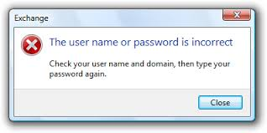
Validation
Checking whether data entered is reasonable,
sensible and allowable.
Sometimes you only want to allow the user to input certain numbers.
We have used selection and Boolean conditions to produce error messages if they don’t.
Now we are going to use iteration (loops) to keep getting input until the data is allowable.
Notes:
Remind students what a range is.
Link to maths.

Slide 4
Validation - The Algorithm
1. Get the input & store in a variable.
2. Start the loop, set the condition to repeat whilst the input is not the same as the desired data.
3. Output an error message.
4. Get the input again, store in the same variable as before.
5. End the loop
6. Output a success message
Notes:
Remind students what a range is.
Link to maths.

Slide 5
Validation with text - how to code
2. Start a while loop with conditions that check for undesirable input. The loop should keep running while the input is NOT what you want.
Get the input.
password = “pa55w0rD”
userPW = input(“Enter your password”)
while userPW != password:
userPW = input(“Password incorrect, try again”)
print(“Password accepted”)
4. Success message once the loop has ended. It will only display this once the loop has stopped.
3. Get the input AGAIN INSIDE THE LOOP.
Notes:
Step 2 - The condition or conditions should check for input that is NOT what is allowed
Step 3 - If this step is missed, the input will never change, the loop will stay true and will continue infinitely.
Step 4 - only displays once the loop conditions are false - this breaks the loop and the program moves on to this line.

Slide 6
Validation with a range - how to code
Using iteration will allow you to make the user try again if the data entetered is not allowable.
Get the input.
3. Success message once the loop has ended. It will only display this once the loop has stopped.
num1 = input(“Enter a number between 1 and 10”)
while num1 < 1 or num1 > 10:
Num1 = input(“Number not in range, try again please”)
print(“Thank you”)
2. Start a while loop with conditions that check for undesirable input. The loop should keep running while the input is NOT what you want.
Notes:
Step 2 - The condition or conditions should check for input that is not allowed and keep looping as long as this is true.
Step 3 only displays once the loop conditions are false - this breaks the loop and the program moves on to this line.

Slide 7
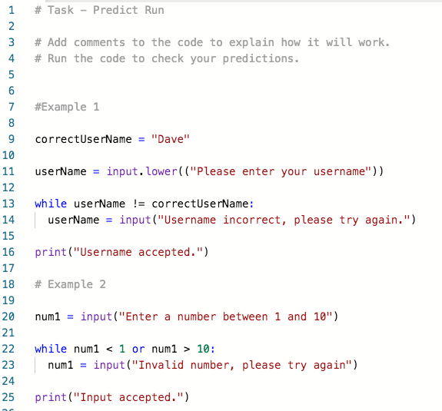
Task - Predict & Run

Slide 8
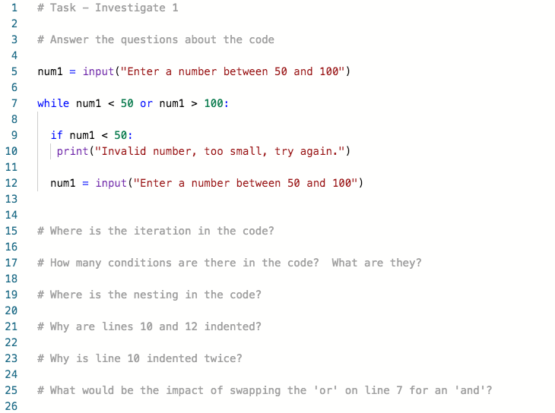
Task - Investigate
Notes:
Take the time to examine the nesting of the IF inside the loop. How is indenting used to do this?

Slide 9
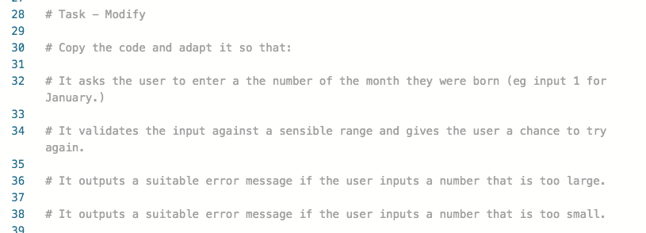
Task - Modify
Notes:
This will require

Slide 10
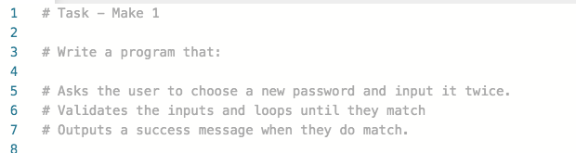
Task - Make 1

Slide 11
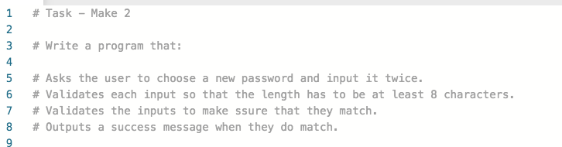
Task - Make 2
Notes:
A more complex version of make 1 that brings in the len function from earlier in the unit.

